Slide 1
Beyond Classical Search – Local Search
Dr. Daisy Tang

Slide 2
Search Algorithms So Far
Designed to explore search space systematically:
keep one or more paths in memory
record which have been explored and which have not
a path to goal represents the solution

Slide 3
Local Search Algorithms
In many optimization problems, the path to the goal is irrelevant; the goal state itself is the solution
State space = set of "complete" configurations
Find configuration satisfying constraints, e.g., n-queens
In such cases, we can use local search algorithms
keep a single "current" state, try to improve it
use very little memory – usually a constant amount
find reasonable solutions in large or infinite state spaces for which systematic solutions are unsuitable
useful for solving optimization problems, e.g. Darwinian evolution, no “goal test” or “path cost”

Slide 4

Example: n-Queen Problem
Put n queens on an n × n board with no two queens on the same row, column, or diagonal

Slide 5
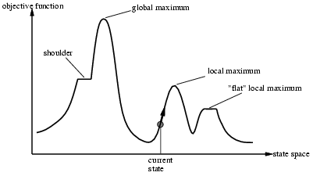
State Space Landscape
Problem: depending on initial state, can get stuck in local maxima/minima

Slide 6
Example: Initial State
GOLD
Assume the objective function measures the straight-line distance

Slide 7
Example: Local Minima
GOLD
<< I am stuck
Assume the objective function measures the straight-line distance

Slide 8
Example: A Plausible Solution
Making some “bad” choices is actually not that bad
GOLD
Assume the objective function measure the straight-line distance

Slide 9
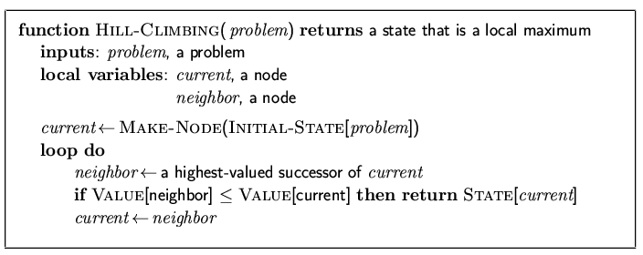
Hill-Climbing Search
"Like climbing Everest in thick fog with amnesia"

Slide 10
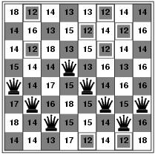
Example: 8-Queen
h = number of pairs of queens that are attacking each other, either directly or indirectly
h = 17 for the above state

Slide 11
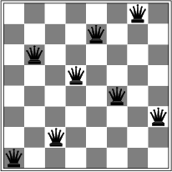
Example: 8-Queen
A local minimum with h = 1

Slide 12
More on Hill Climbing
Complete? Optimal?
Hill climbing is sometimes called greedy local search
Although greedy algorithms often perform well, hill climbing gets stuck when:
Local maxima/minima
Ridges
Plateau (shoulder or flat local maxima/minima)
The steepest-ascent hill climbing solves only 14% of the randomly-generated 8-queen problems with an avg. of 4 steps
Allowing sideways move raises the success rate to 94% with an avg. of 21 steps, and 64 steps for each failure

Slide 13
Variants of Hill Climbing
Stochastic hill climbing:
chooses at random from among uphill moves
converges more slowly, but finds better solutions in some landscapes
First-choice hill climbing:
generate successors randomly until one is better than the current
good when a state has many successors
Random-restart hill climbing:
conducts a series of hill climbing searches from randomly generated initial states, stops when a goal is found
It’s complete with probability approaching 1

Slide 14
More on Random-Restart Hill Climbing
Assume each hill climbing search has a probability p of success, then the expected number of restarts required is 1/p
For 8-queen problem, p = 14%, so we need roughly 7 iterations to find a goal
Expected # of steps = cost_to_success + (1-p)/p * cost_to_failure
Random-restart hill climbing is very effective for n-queen problem
3 million queens can be solved < 1 min

Slide 15
Some Thoughts
NP-hard problems typically have an exponential number of local maxima/minima to get stuck on
A hill climbing algorithm that never makes “downhill” (or “uphill”) moves is guaranteed to be incomplete
A purely random walk – moving to a successor chosen uniformly at random – is complete, but extremely inefficient
What should we do?
Simulated annealing

Slide 16
What is Simulated Annealing?
The process used to harden metals and glass by heating them to a high temperature and then gradually cooling them, thus allowing the material to reach a low-energy crystalline state

Slide 17
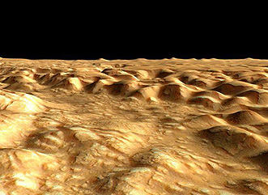

Ping-Pong Ball Example

Slide 18
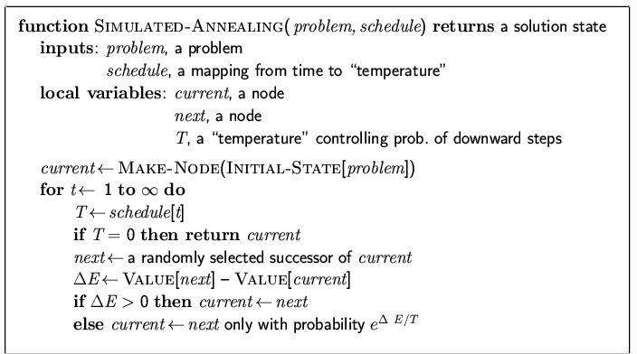
Simulated Annealing
Idea: escape local maxima by allowing some "bad" moves but gradually decrease their frequency

Slide 19
Analysis of Simulated Annealing
One can prove: If T decreases slowly enough, then simulated annealing search will find a global optimum with probability approaching 1
Widely used in VLSI layout, airline scheduling, etc.
An example: http://foghorn.cadlab.lafayette.edu/fp/fpIntro.html

Slide 20
Local Beam Search
Idea:
Keep track of k states rather than just one
Start with k randomly generated states
At each iteration, all the successors of all k states are generated
If any one is a goal state, stop; else select the k best successors from the complete list and repeat
Is it the same as running k random-restart searches?
Useful information is passed among the k parallel search threads
Stochastic beam search: similar to natural selection, offspring of a organism populate the next generation according to its fitness

Slide 21
Genetic Algorithms
A successor state is generated by combining two parent states
Start with k randomly generated states (population)
A state is represented as a string over a finite alphabet (often a string of 0s and 1s or digits)
Evaluation function (fitness function). Higher values for better states
Produce the next generation of states by selection, crossover, and mutation
16257483

Slide 22
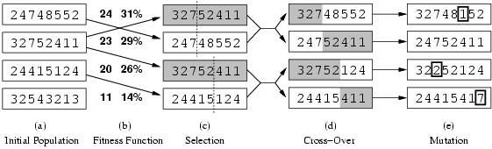
Genetic Algorithms
crossover point
Fitness function: number of non-attacking pairs of queens (min = 0, max = 8 × 7/2 = 28)
24/(24+23+20+11) = 31%
23/(24+23+20+11) = 29% etc

Slide 23
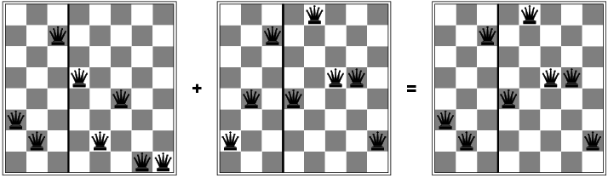
Example: 8-Queen

Slide 24
Example: TSA
http://www.obitko.com/tutorials/genetic-algorithms/

Slide 25
More on Genetic Algorithms
Genetic algorithms combine an uphill tendency with random exploration and exchange of information among parallel search threads
Advantages come from “crossover”, which raise the level of granularity

Slide 26
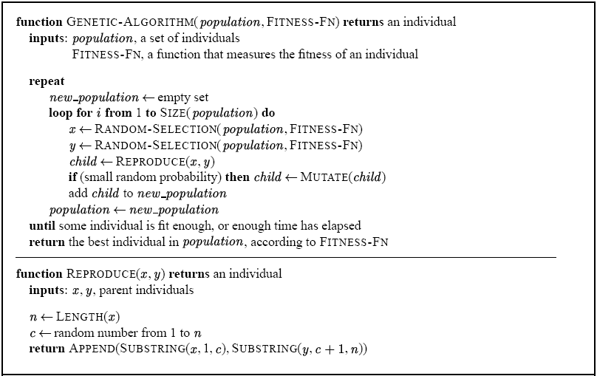
A Genetic Algorithm

Slide 27
In-Class Exercise #4.1
Give the name of the algorithm that results from each of the following special cases:
Local beam search with k = 1
Local beam search with one initial state and no limit on the number of states retained
Simulated annealing with T = 0 at all times (and omitting the termination test)
Genetic algorithm with population size N = 1

Slide 28
Searching With Partial Information
We have covered: Deterministic, fully observable → single-state problem
agent knows exactly which state it will be in
solution is a sequence
Deterministic, non-observable → multi-state problem
Also called sensorless problems (conformant problems)
agent may have no idea where it is
solution is a sequence
Nondeterministic and/or partially observable → contingency problem
percepts provide new information about current state
often interleave search, execution
solution is a tree or policy
Unknown state space → exploration problem (“online”)
states and actions of the environment are unknown

Slide 29
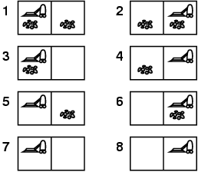
Example: Vacuum World
Single-state, start in #5. Solution?
[Right, Suck]
Multi-state, start in #[1, 2, …, 8]. Solution?
[Right, Suck, Left, Suck]

Slide 30
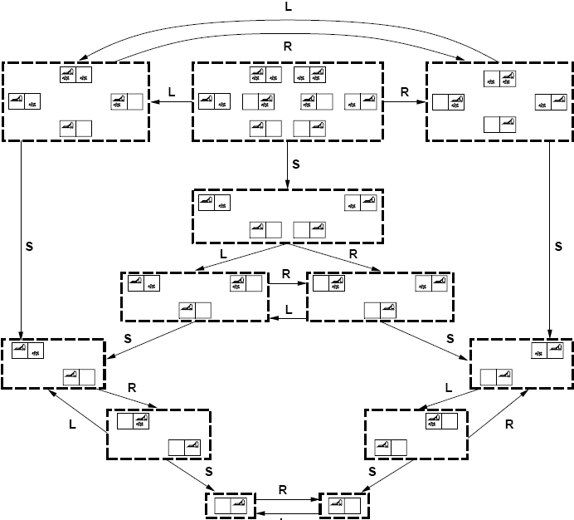
Sensorless (multi-state problem)

Slide 31
Contingency Problem
Contingency, start in #5 & 7.
Nondeterministic: suck may dirty a clean carpet
local sensing: dirt, location only at current location
Solution?
Percept: [Left, Clean] → [Right, if dirty then Suck]

